Slide 1

Algorithmic Trading Strategy Using Two Moving Averages ——Optimized by ARMA Model
Candidate: Huang Zixing

Slide 2

A. PROBLEM MOTIVATION
Notes:
The stock market has always been deemed to be too arbitrary to predict but as the modern technology advances, quantitative investment strategies or algorithmic trading also foster. There are a number of different strategies, old and new, coming up every day, with a sole purpose in mind of being able to beat the market and make profit.
Quant strategies are now used widely by mutual funds, hedge funds and individual investor. One of the prominent selling-point of quantitative investment over traditional trading is that the algorithm will decide the stock and its position Buy/Sell/Hold, completely eliminating human's potential for bias and error.
The roadblock is that there is no one single perfect strategy, each has its own strengths and weakness. As a result, if a portfolio can use multiple strategies instead of having to choose one, it will be more likely to generate profit. Inspired to solve this problem, we attempt to integrate optimization model into the mixture of trading strategies. In this project, we will construct a trading system using mean-reversion or momentum strategies. The optimization model will play the role of creating the optimal portfolio and consequentially pick the most suited strategy for each stock.

Slide 3


Two Moving Averages Strategy
Through the establishment of m-day moving average and n-day moving average, there must be an intersection between the two moving averages. If m>n, the n-day moving average "upward crosses" the m-day moving average, which is the buying point, otherwise it is the selling point. This strategy is based on the intersection of the moving averages of different days and seizes the strong and weak moments of stocks/futures to trade.
The possibility that the trend might not be persistent or be misinterpreted, as a result, causing a loss.

Slide 4
Two Moving Averages Strategy
Buying/Selling Point:
Buying Point: (Also be called " Golden Cross ")
Empty position and the short-period MA "upward crosses" the long-period MA
Selling Point: (Also be called " Death Cross ")
Full position and the short-period MA “downward crosses" the long-period MA

Slide 5
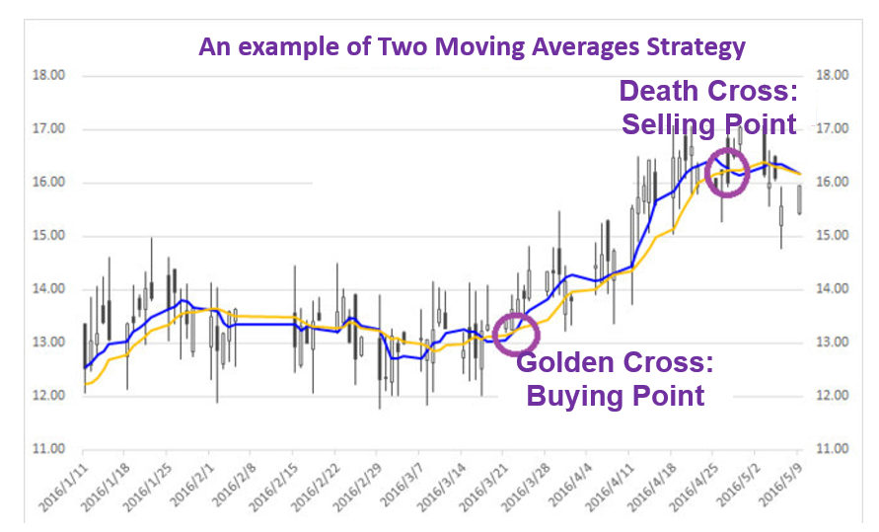
MA5
MA20

Slide 6
Two Moving Averages Strategy ——An example of Trend Strategy
Trend strategy is relatively the opposite to mean-reversion. Under Trend Strategy, you will buy stocks/futures that has upward trend as we expect that the increasing trend will continue.
The possibility that the trend might not be persistent or be misinterpreted, as a result, causing a loss.
Notes:
Is relatively the opposite strategy to mean-reversion. Under Trend Strategy, you will buy stocks/futures which have upward trend as we expect that the increasing trend will continue. The downside of trend strategy is the possibility that the trend might not be persistent or be misinterpreted, as a result, causing a loss.

Slide 7
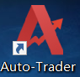

Software
Auto-Trader(Atrader) is a software which was designed by the Digquant Company, China. It provides a series of Python-based data query, account information query, transaction order, strategy backtest, real trading, stop profit and stop loss functions. Atrader uses the SDK method, users only need to install atrader, and they can write strategies in the IDE.

Slide 8
Basic Code
1. Input Library
from atrader import * # Start using the Auto-Trader
import numpy as np
2. Initialize Function
3. Set logic function of strategy operation
4. Strategy Execution Script

Slide 9
Code: Initialize Function
def init(context):
# Register the data of the investment targets
reg_kdata('day',1) # Set the frequency of the data as one-day
# Set the detail of backtest
set_backtest(initial_cash=1e8) # Initialize the total account money is 100,000,000
# Define the parameters/features
context.win = 21 # The length of data which we need to operate the strategy
# (e.g. We need to use MA20, so we need to get the data from 20 days before today to today.)
context.long_win = 20 # 20-Day Moving Average Line(Long Time Trend)
context.short_win = 5 # 5-Day Moving Average Line(Short Time Trend)
context.Tlen = len(context.target_list) # The number of classes of investment targets
We use Rebar Future as an example of investing target, so we write the code:
target_list=['SHFE.rb0000’]

Slide 10
Code: Set logic function of strategy operation（1/3）
def on_data(context):
# Get the registering data of investment targets
data = get_reg_kdata(reg_idx=context.reg_kdata[0], length=context.win, fill_up=True, df=True) # The data of candlestick chart of all investment targets
if data_train['close'].isna().any(): # If the data is NaN, then skip it
return
close = data.close.values.reshape(-1, context.win).astype(float) # Get the close price and store it in a 2-dimession ndarray
# Check situation of current position
positions = context.account().positions['volume_long'].values # Get the information of the current position
# e.g. Positions=0，means have not holden any of this investment target

Slide 11
Code: Set logic function of strategy operation （2/3）
# Logic Calculation
mashort = close[:, -5:].mean(axis=1) # Short-period MA Line：MA5
malong = close[:, -20:].mean(axis=1) # Long-period MA Line：MA20
target = np.array(range(context.Tlen)) # Get the Index of Investment Targets
pred_price = []
# Buying/Selling Point
long = (positions == 0) & (mashort > malong) # Empty position and the short-period MA "upward crosses" the long-period MA
short = (positions > 0) & (mashort < malong) # Full position and the short-period MA “downward crosses" the long-period MA
target_long = target[long].tolist() # Print the index of investment targets which we bought in
target_short = target[short].tolist() # Print the index of investment targets which we sold out

Slide 12
Code: Set logic function of strategy operation （3/3）
# Trading by using strategy
for targets in target_long:
# Action of buying in
order_target_value(account_idx=0, target_idx=targets, target_value=1e8/context.Tlen, side=1,order_type=2, price=0)
for targets in target_short:
# Action of selling out
order_target_volume(account_idx=0, target_idx=targets, target_volume=0, side=1,order_type=2, price=0)

Slide 13
Code: Strategy Execution Script
# We use Rebar Future as an example of investing target, so we write the code:
“SHFE” means “Shanghai Future Exchange”
if __name__ == '__main__':
# Strategy Backtest Function
run_backtest(strategy_name='TwoLines', file_path='.', target_list=['SHFE.rb0000'],
frequency='day', fre_num=1, begin_date='2017-01-01', end_date=‘2017-12-31', fq=1)

Slide 14
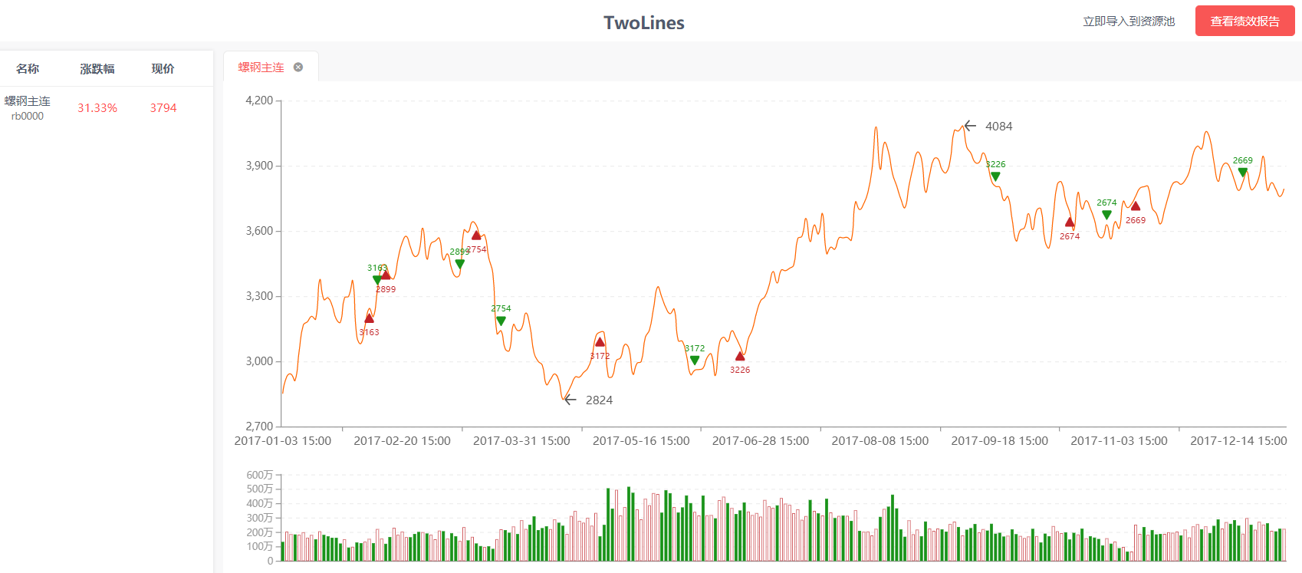
Backtest Result
Target name
Current
Price
Total Return
Buy
Sell

Slide 15
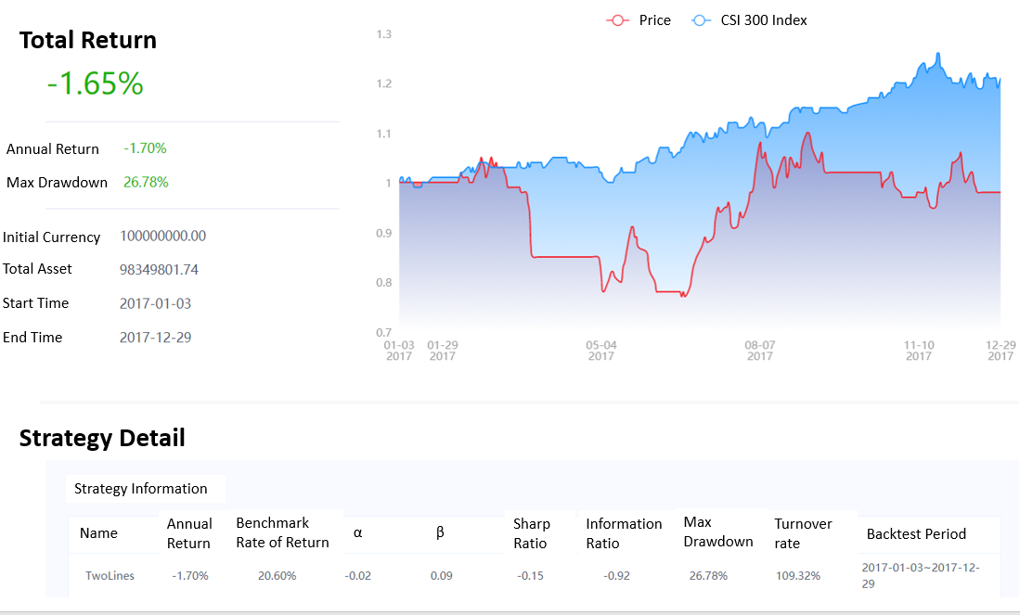

Slide 16

Optimized by Using ARMA Model
Using a common Time-series Model to optimize the Simple Two MA Lines Trend Strategy
How do this strategy increase the return of initial transaction strategy?

Slide 17
ARMA - Introduction
Autoregressive process
-Series current values depend on its own previous values
-AR(p): current values depend on its own p-previous values
-p is the order of AR process
Moving average process
-The current deviation from mean depends on previous deviations
-MA(q): current deviation from mean depends on q-previous deviations
-q is the order of MA process
Autoregressive moving average process: ARMA

Slide 18
Autoregressive (AR) models
A pth-order autoregressive model
Autoregressive models are appropriate for stationary time series
dependent variable at t
dependent variables at time lags t-1, t-2, …, t-p
error term at t
coefficients to be estimated

Slide 19
Moving average (MA) models
A q^{th}-order moving average model
MA models provide forecasts of Y_{t} based on a linear combination of a finite number of past errors
whereas AR models forecast Y_{t} as a linear function of a finite number of past values of Y_{t}.
dependent variable at t
error term at t
errors in previous time periods, at time lags t-1, t-2, …, t-p
constant mean of the process
coefficients to be estimated

Slide 20
Two Moving Averages Strategy – opt by ARMA
Buying/Selling Point: (Add the ARMA Prediction as the Reference)
Buying Point: (Also be called " Golden Cross ")
Empty position and the short-period MA "upward crosses" the long-period MA and the ARMA Model prediction result shows price of investment targets rising up
Selling Point: (Also be called " Death Cross ")
Full position and the short-period MA “downward crosses" the long-period MA and the ARMA Model prediction result shows price of investment targets falling down

Slide 21
Basic Code
1. Input Library
from atrader import * # Start using the Auto-Trader
import numpy as np
from pmdarima import auto_arima # Start using the ARIMA Model
2. Initialize Function
3. Set logic function of strategy operation
4. Strategy Execution Script

Slide 22
Code: Initialize Function
def init(context):
# Register the data of the investment targets
reg_kdata('day',1) # Set the frequency of the data as one-day
# Set the detail of backtest
set_backtest(initial_cash=1e8) # Initialize the total account money is 100,000,000
# Define the parameters/features
context.win = 21 # The length of data which we need to operate the strategy
# (e.g. We need to use MA20, so we need to get the data from 20 days before today to today.)
context.long_win = 20 # 20-Day Moving Average Line(Long Time Trend)
context.short_win = 5 # 5-Day Moving Average Line(Short Time Trend)
context.Tlen = len(context.target_list) # The number of classes of Investment targets
context.armawin = 30 # The length of data to train the ARMA Model
# (more than Long-Period MA is preferred)

Slide 23
Code: Set logic function of strategy operation（1/3）
def on_data(context):
# Get the registering data of investment targets
data = get_reg_kdata(reg_idx=context.reg_kdata[0], length=context.win, fill_up=True, df=True) # The data of candlestick chart of all investment targets
data_train = get_reg_kdata(reg_idx=context.reg_kdata[0], length=context.armawin, fill_up=True, df=True) # The data of candlestick chart of all investment targets to train or fit the ARMA Model
if data_train['close'].isna().any(): # If the data is NaN, then skip it
return
close = data.close.values.reshape(-1, context.win).astype(float) # Get the close price and store it in a 2-dimession ndarray
close_train = data_train.close.values.reshape(-1, context.armawin).astype(float) # Get the close price which will use to train or fit ARMA Model and store it in a 2-dimession ndarray
# Check situation of current position
positions = context.account().positions['volume_long'].values # Get the information of the current position
# e.g. Positions=0，means have not holden any of this investment target

Slide 24
Code: Set logic function of strategy operation （2/3）
# Logic Calculation
mashort = close[:, -5:].mean(axis=1) # Short-period MA Line：MA5
malong = close[:, -20:].mean(axis=1) # Long-period MA Line：MA20
target = np.array(range(context.Tlen)) # Get the Index of Investment Targets
pred_price = []
for train in close_train:
# For train data of all investment targets, then we use it to train the ARMA Model
arima_model = auto_arima(train,
start_p = 0,
start_q = 0,
max_p = 6,
max_q = 6,
seasonal = False,
trace = False,
error_action = 'ignore',
suppress_warnings = True,
stepwise = False)
pred_price.append(arima_model.predict(1)[0]) # The result of ARMA Moving Single-step Prediction

Slide 25
Code: Set logic function of strategy operation （2.5/3）
close_now = np.array([x[-1] for x in close])
pred_price = np.array(pred_price)
# Buying/Selling Point
long = ((positions == 0) & (mashort > malong)) & (close_now < pred_price) # Empty position and the short-period MA "upward crosses" the long-period MA and the ARMA Model prediction result shows increasing
short = ((positions > 0) & (mashort < malong)) & (close_now > pred_price) # Full position and the short-period MA “downward crosses" the long-period MA and the ARMA Model prediction result shows decreasing
target_long = target[long].tolist() # Print the index of investment targets which we bought in
target_short = target[short].tolist() # Print the index of investment targets which we sold out

Slide 26
Code: Set logic function of strategy operation （3/3）
# Trading by using strategy
for targets in target_long:
# Action of buying in
order_target_value(account_idx=0, target_idx=targets, target_value=1e8/context.Tlen, side=1,order_type=2, price=0)
for targets in target_short:
# Action of selling out
order_target_volume(account_idx=0, target_idx=targets, target_volume=0, side=1,order_type=2, price=0)

Slide 27
Code: Strategy Execution Script
# We use Rebar Future as an example of investing target, so we write the code:
“SHFE” means “Shanghai Future Exchange”
if __name__ == '__main__':
# Strategy Backtest Function
run_backtest(strategy_name='TwoLines_ARMA', file_path='.', target_list=['SHFE.rb0000'],
frequency='day', fre_num=1, begin_date=‘2017-01-01', end_date=‘2017-12-31', fq=1)

Slide 28
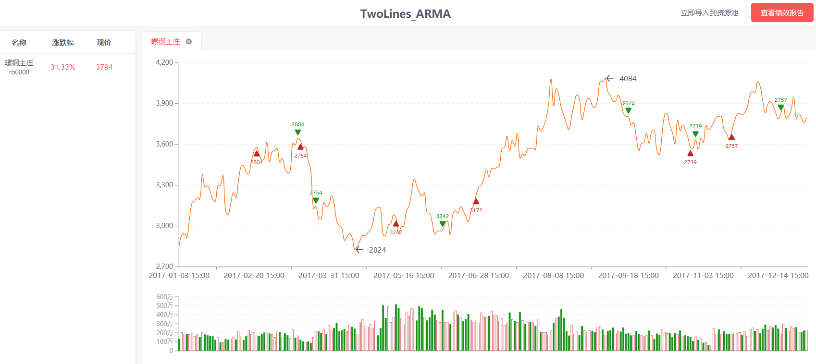
Backtest Result
Target name
Current
Price
Total Return
Buy
Sell

Slide 29
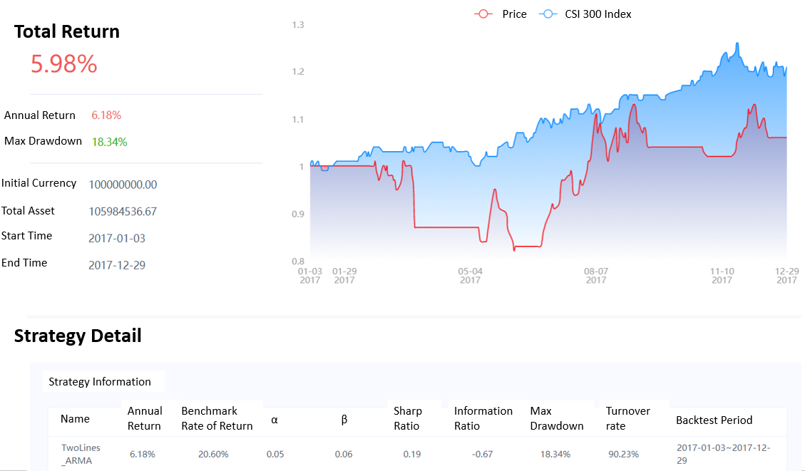

Slide 30
Compare
Total No. of Transactions
Simple Two Lines: 14
Two Lines_ARMA: 12
Total Return
Simple Two Lines: -1.65%
Max Drawdown
Simple Two Lines: 26.78%
Two Lines_ARMA: 5.98%
Two Lines_ARMA: 18.34%

Slide 31
Conclusion
We find that Two Lines Strategy optimized by ARMA Model improved the Simple Two Line Strategy’s return by using Time-Series Prediction. Through using accurate predicting of price of stocks/futures to decrease the number of transactions and control the backtest. As an example of Rebar Future in 2017 by using daily data, it can excess 7.63% of return compared by Simple Two Lines Strategy.

Slide 32
Thanks!

Slide 33
Reference
1. Two Lines Strategy
https://blog.csdn.net/ydjcs567/article/details/61616387
2. ARMA
Prof. He Long’s PPT in Course DBA5106: Foundation in Business Analytics of MSBA in NUS
3. Backtest Figures
Auto-Trader Software designed by Digquant Corporation

